Slide 1
Structures of operating system.
GROUP NO 12

Slide 2
Monolithic system

Slide 3
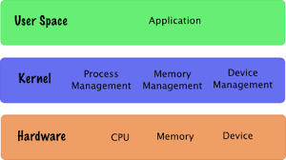
MONOLITHIC SYSTEM:
Monolithic system is very basic OS in which common system components like file management, memory management, device management, and process management is directly controlled within the kernel.
It has all the permissions to call whatever it wants(modules and packages of procedures).
This can lead to a messy system.

Slide 4
History:
Operating systems which use monolithic architecture were first time used in the 1970’s.
Earlier computer system were relatively simple having a single CPU , a small size memory and few input/output devices. In order to manage these simple systems, monolithic kernels were best suited in.

Slide 5
Features of the Monolithic operating system:
1. Simple structure:
This type of operating system has a simple structure. All the components needed for processing are embedded into the kernel.
2. Works for smaller tasks:
It works better for performing smaller tasks as it can handle limited resources.
3. Communication between components:
All the components can directly communicate with each other and also with the kernel.
4. Fast operating system:
The code to make monolithic kernel is very fast and robust.

Slide 6
Limitations of a monolithic operating system:
Code written in this operating system (OS) is difficult to port.
Monolithic OS has more tendency to generate errors and bugs. The reason is that user processes use same address locations as the kernel.
Adding and removing features from monolithic OS is very difficult. All the code needs to be rewritten and recompiled to add or remove any feature.

Slide 7
LAYERED SYSTEM Structure

Slide 8
WHAT IS LAYER BASED OS?
The OS consists of many layers.
Each layer is well defined.
They are arranged in increasing order of abstraction.
Examples of different layers : File management layer, communication management layer, user program layer etc.

Slide 9
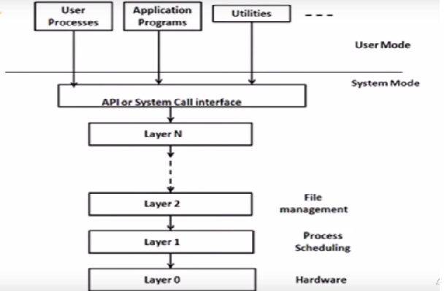
Layered architecture of Operating system.

Slide 10
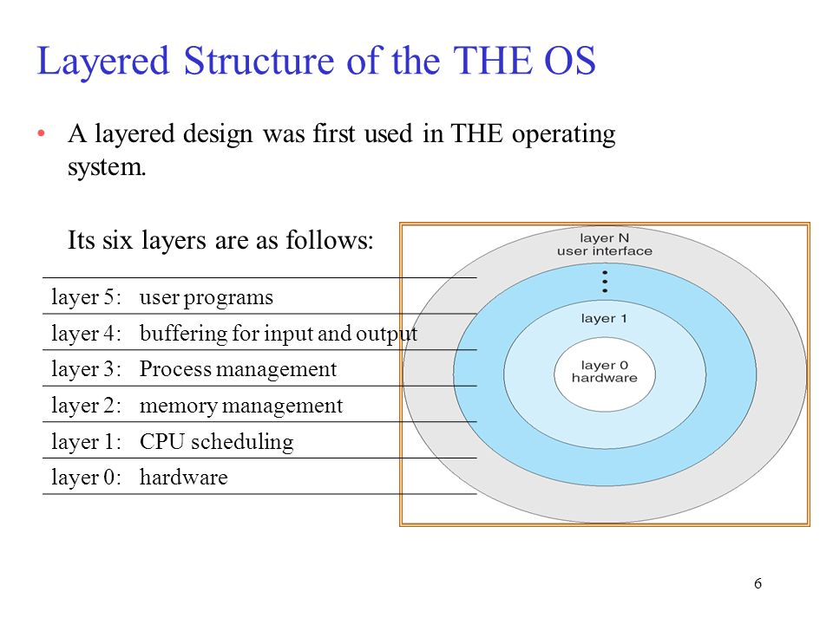
THE OS OPERATING SYSTEM

Slide 11
ADVANTAGES AND DISADVANTAGES
ADVANTAGES | DISADVANTAGES
Easy to add new features. | More layers lead to more overhead.
Easy to remove bugs. | Unequal division of functions.
New layers can be easily added.

Slide 12
Virtual machinE

Slide 13
DEFINITION
Virtual machines are based on computer architectures and provide functionality of a physical computer
A Virtual machines provides an interface identical to the underlying bare hardware.
In other words, virtual machines behave as separate computer systems.
It can used to run applications and any operating systems

Slide 14
Why use a virtual machine
To perform specific tasks that are risky to perform in a host environment.
The software inside the virtual machine cannot tamper with the host computer.
Virtual machines can also be used for other purposes such as server virtualization.

Slide 15
Types
Process virtual machines:
Execute computer programs in a platform-independent environment.
It masks the information of the underlying hardware or operating system. This allows the program to be executed in the same fashion on any platform.
System virtual machines:
Support the sharing of a host computer’s physical resources between multiple virtual machines.

Slide 16
Advantages and disadvantages
Advantages of Virtual Machines:
Provides disaster recovery and application provisioning options
Virtual machines are simply managed, maintained, and are widely available
Multiple operating system environments can be run on a single physical computer
Disadvantages of Virtual Machines:
Running multiple virtual machines on one physical machine can cause unstable performance
Virtual machines are less efficient and run slower than a physical computer

Slide 17
MICRO KERNAL

Slide 18
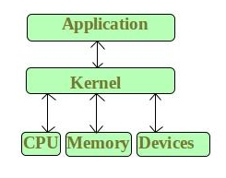
KERNEL
Kernel is the core part of an operating system which manages system resources. It also acts like a bridge between application and hardware of the computer. It is one of the first programs loaded on start-up (after the Boot loader).
The CPU can execute certain instruction only when it is in the kernel mode. These instruction are called privilege instruction. For example, instruction for managing memory protection.
User-level instruction does not require special privilege. Example are ADD, PUSH, etc.

Slide 19
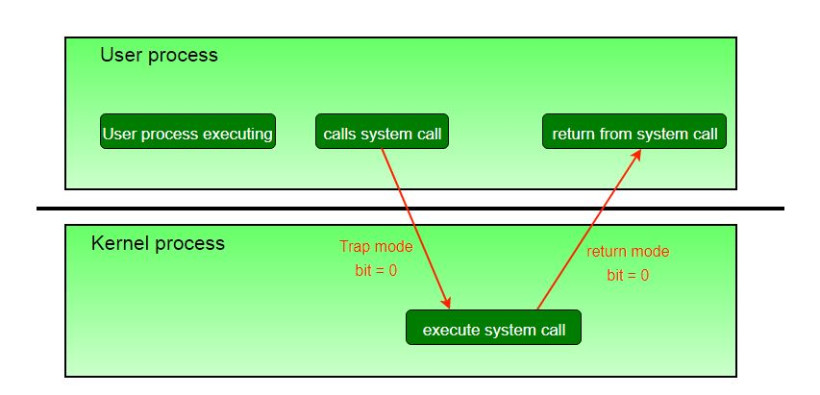
KERNEL AND USER MODE CPU OPERATION
The operating system puts the CPU in kernel mode when it is executing in the kernel so, that kernel can execute some special operation.
The operating system puts the CPU in user mode when a user program is in execution so, that user program cannot interface with the operating system program.

Slide 20
MICROKERNEL
Microkernel is one of the classification of the kernel. Being a kernel it manages all system resources.
But in a microkernel, the user services and kernel services are implemented in different address space, thus also reduces the size of kernel and size of operating system as well.
It provides minimal services of process and memory management.
Inter-process communication (IPC) is any mechanism which allows separate processes to communicate with each other, usually by sending messages.
Microkernel servers are essentially daemon programs like any others, except that the kernel grants some of them privileges to interact with parts of physical memory that are otherwise off limits to most programs.

Slide 21
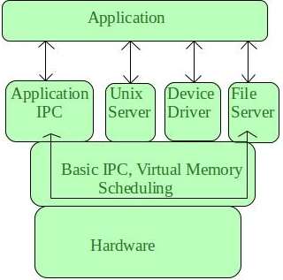

Slide 22
ADVANTAGE
DISADVANTAGE
The architecture of this kernel is small and isolated hence it can function better.
Expansion of the system is easier, it is simply added in the system application without disturbing the kernel.
Due to the modularity of the kernel, code readability is better maintenance of the operating system is much easier.
Fewer system crashes when compared with monolithic systems.
Since there is more IPC going on, so it makes the system slower.
Messaging bugs can be harder to fix due to the longer trip they have to take.
Providing services in a microkernel system are expensive compared to the normal monolithic system.

Slide 23
Client server model

Slide 24
Client-Server Model
It is a variation of the microkernel system
Client – Application
Server – Middle layer of Microkernel
Client – Sends request
Server – Replies to request
Eg. File fetching

Slide 25
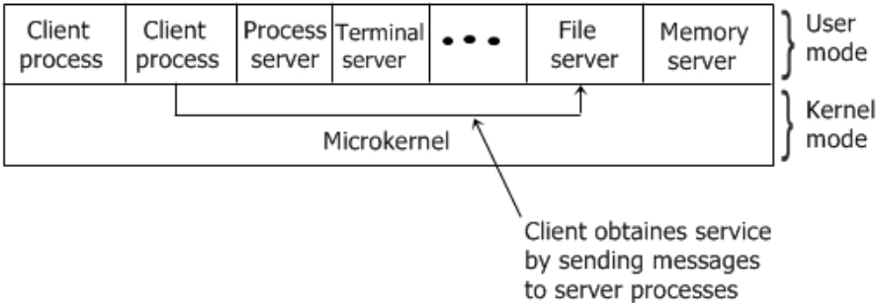
Client-Server Model
Kernel handles the communication between the clients and the servers
The adaptability of the client-server model, to use in distributed system is the advantage of this model.

Slide 26
EXOKERNAL

Slide 27
Exokernels
Subset of Virtual Machines
Disks are actually partitioned
It is program running in kernel mode
Resources are allocated while setting up
Different OS may be installed on different Partitions.
Partition is called as exokernel

